Slide 1
Dev Center - Update
Weekly Leadership Report
Week Ending Mar 20th, 2015

Slide 2
Highlights
Status Count
9
1
1
QE Phase 2 moved back to green
Provisioning UI moved from Red to Amber
RDC Delivery Manager in Castle to oversee PUI March delivery
PUI – SSM candidate interviewed; waiting final approval
RDC Oracle DBA is in Castle to get KT and orientation
RDC second Oracle DBA joined the team

Slide 3


Dev Center | Active Projects
Owner | RAX Needs | Platform | Overall Health Indicator | Resource Types | Partner Investment | Current Stage | % Complete | Date of Start | Expected Completion | Comment
Andy Crockett | Marketing Acquisition Funnel | Informatica, Qlikview |  | Informatica Lead/BA/Data Modeler PM | NA | In Dev | 46% | 25 Jul 14 | 9 Jun 15 | Site Visit: Subject area in production Lead: The dependency issue on Michael Graham still exist and EBI team following up. This is a blocker for last 4 weeks and the project will turn amber if not resolved Opportunity: Mapping specifications development in progress. Sign up and Activation: BRD review completed CR: Greg confirmed CR put in Contrax, not yet received
Cesar Garza | SAM/NWT | Python |  | PM, BA, PE, Python | 2 weeks onsite 6 weeks Dev Center | Sprint in progress | NA | 16 Sep 14 | NA | Sprint 92 in progress and on track. NIS UI prod deployment planned
Chris Brown | NGAF | .NET, Angular |  | PM, BA, PE, .NET, Angular | 2 weeks onsite 6 weeks Dev Center | Sprint in progress | NA | 16 Sep 14 | NA | Sprint 92 in progress and on track. Sprint 90, 91 demo covering feedback items from previous demo and Trend charts (with open issues) well received. - Resourcing QE interview scheduled on March 25th
David Mills | Rapid Response team | Angular JS |  | SM, BA, Dev | NA | Sprint in progress | NA | 24 Feb 15 | NA | RRT team working on 4 projects in parallel. On track pending minor issues
Greg Nelson | Workflow / Tools Migration(Core Data sets) | Informatica |  | Tech Mgr., Dev, QE, PM | N/A | Team working as extended Data team | NA | 12 Jun 14 | NA | Working on Billing Events, Tickets CDS architecture. SOW submitted, not yet received
Jeremy Scardino | Object Rocket extended team | Python, Angular JS |  | Python, Angular JS | N/A | Team working as extended OR team | N/A | 27 Oct 14 | NA | Team embedded as part of Object Rocket Scrum team
Pradip Dhaduk | BRM extended team | BRM |  | BRM Arch, Tech Lead, BA, Developers | N/A | Team working as extended BRM team | N/A | 01 Jul 14 | NA | Team embedded as part of Rackspace BRM Scrum team
Parichai K | Oracle DBA extended team | Oracle |  | Oracle DBA | N/A | Team working as extended DBA team | N/A | 04 Mar 15 | NA | One team member in Castle for orientation and KT

Slide 4


Dev Center | Active Projects
Owner | RAX Needs | Platform | Overall Health Indicator | Resource Types | Partner Investment | Current Stage | % Complete | Date of Start | Expected Completion | Comments
Sam Danes | QE Phase 2 | OpenCafe |  | Python, OpenCafe | NA | In Dev | 35% | 13 Jan 15 | June 2015 | Sync processes BTUP, BUUP and CSUP completed. Sync processes DNUP, CIUP, CSFP development in progress Major blocker for Dev Team: Erratic behavior of the Dev Environment Project moved from Amber to Green
David Schrader | Provisioning Reengineering | UX, Business Analysis |  | PM, BA, UI/UX | 100k | Sprint in progress | NA | 01 Nov 2014 | TBD | Sprint #3 concluded, demon completed from local Sprint #4 in progress, goal is to port the application to staging Test scripts development in progress Project moved from Red to Amber. Reason for Amber: Application not deployed in staging, Test Scripts not completed PATH TO GREEN: Setup application on staging by March end Track and improve code quality & quantity. Venu & Chris to come up with goals and metrics for code quality and quantity
Clayton Scott | ARIC | .NET, Angular, MxGraph |  | PM, BA, PE, .NET, Angular | 2 weeks onsite 6 weeks Dev Center | Starting Sprint 1 | NA | 16 Sep 14 | TBD | RDC Sprint 92 in progress. Process quick link call out in production. AutoCall UI Dev Done. Communication API (for AutoCall), Process List UI, module-to-process-element-connection UI in progress. Production Defect fixes delivered Resourcing Total positions: 8 1 JS/MxGraph: Team decided to have a Angular JS resource for this position. One candidate interviewed and rejected 2 QE: One engineer selected, second QE identified, to schedule interview Reason for Red: Insufficient staffing of resources PATH TO GREEN: Closely monitor and track Sprint 2. Immediate staffing of remaining Dev Center resources. Plan is to turn the project green by end of first two sprints

Slide 5
Completed Project With Refactoring Need
RAX Needs | Platform | Model | Res Needed | Size (pd) | Size ($) | Partner Investment | Current Stage | Effort Consumed (pd) | Projected Effort Variance | Date of Start | Expected Completion | Comment
Financial Data Mart - SoW1 | OCDM, OBIA, EBS, BRM | Fixed Price | 11 |  | 300K | Discovery | In Production |  |  | June 14 | Jan 15 | - Project handed over with all documentation. Sign-off complete. Warranty support is over on Mach 19th Awaiting on business users to finalize the Business user training dates.

Slide 6
Dev Center | Pipeline Projects
Owner | RAX Needs | Platform | Stage | Resources Onboard | Expected Start Date | Next Steps
Pradip Dhaduk | eVapt Migration (UK Billing) | ETL Developers BRM | Scope Definition | 4 | TBD | Non commercial SOW discussion completed, Commercial SOW to be submitted by week ending March 27th
Greg Nelson | Fin Data Mart SOW2 | Informatica | Submitted SOW | NA | TBD | SOW submitted to Greg and followed up last week. Greg is awaiting confirmation from Business
Greg Nelson | ETL Developers, OBIEE | Billing Events | LOE submitted | Existing Team | TBD | As per discussion with Greg, Nick and Patrick discussing next steps for this initiative

Slide 7
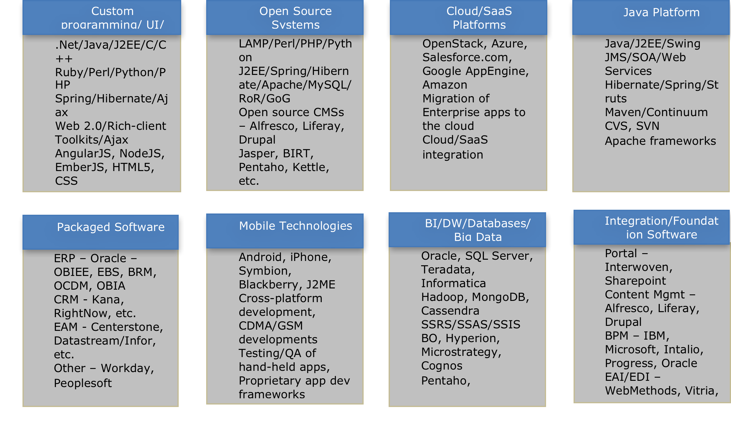
Dev Center | Skillsets

Slide 8
Pending SOW
Owner | Description | Comments | Resources On boarded
Greg N | SOW - Robbie Pacheco | In the system - Not received yet | Yes This SOW ending on 25th March
Greg N | SOW - Thomas Whitney | In the system - Not received yet | Yes
Jerremy S | Object Rocket Language Binding | SOW submitted in Nov. | Yes As per Nikki, this can be invoiced
Parichai K | Oracle DBA | SOW submitted on 2/5 | Yes
Greg N | Marketing Acquisition Funnel - CR | CR Submitted on 2/9. As per Greg this is in Contrax | Yes
Greg N | Tools Migration CR | CR Submitted on 2/9. As per Greg, this project may be repurposed. Repurposed last week | This is no longer required
David M | Rapid Response Team | SOW submitted on 2/19 | Yes
Greg N | SOW for Enterprise Data - CDS Team | Submitted on 3/16 | Yes

Slide 9
Investments
Project | Resource/Team | Rax Owner | Investment | Recurring/ 1Time | Weeks | Time Period | Comments
Investments in Project
BRM | Rajan | Pradip Dhaduk | 15600 | One Time | 3 | April'14 | Investment in initial Kaizen sessions for project scoping
BRM | RJ Kemmel | Pradip Dhaduk | 9000 | One Time | 2.5 | April'14 | Investment in initial Kaizen sessions for project scoping
Object Rocket | 3 member team | Jeremy Scardino | 28800 | One Time | 3 | April - June'14 | 3 Language Bindings done as investment to help prove the model.
QE | Anubha + 1 | Sam Danes | 9600 | One Time | 4 | May - June'14 | Investment to prove the model
Tools Migration/ FDM | Kartheek | Ryan Hawk | 21600 | One Time | 6 | May - July'14 | Investment for FDM and Tools Migration project scoping.
Open Stack | Merryl, Bhavani, 1 more | Product Team | 28800 | One Time | 12 | July'14 - Oct'14 | Working to contribute to Open Stack community
Tools Migration | Tools Migration | Ryan Hawk | 18000 | One Time | - | Sept'14 | Investment in Tools Migration project
Automation - PE | Onsite Team | David Mills | 28160 | One Time | 2 | Oct'14 - Dec'14 | Investment 4 member PE Team
Automation - ARIC | Onsite Team | Clayton Scott | 7600 | One Time | 2 | Sept'14 | Investment 1 BA
Automation - NGAF | Onsite Team | Chris Brown | 7600 | One Time | 2 | Nov'14 | Investment 1 BA
Automation - AI | Onsite Team | Cesar Garza | 15200 | One Time | 2 | Oct'14 - Nov'14 | Investment 1 BA, 1 Cassandra DBA
Automation - ARIC | Dev Center | Clayton Scott | 7680 | One Time | 6 | Nov'14 | Investment 1 Dev Center Resource
Automation - NGAF | Dev Center | Chris Brown | 15360 | One Time | 6 | Nov'14 | Investment 2 Dev Center Resources
Automation - AI | Dev Center | Cesar Garza | 38400 | One Time | 6 | Oct'14 - Nov'14 | Investment 5 Dev Center Resources
ODBC | Satyen | Ryan Hawk | 5600 | One Time | 4 | Oct'14 | Investment in ODBC Project.
Provisioning | Ramesh | Chris LeClair | 63000 | One Time | 29 | May 19 - Nov 9th | Initial discussions, Meeting with various teams, Project kick-off
Provisioning | Kapil | Chris LeClair | 33000 | One Time | 15 | Aug 1 - Nov 13 | Wireframe discussions, team meetings
Provisioning | UI Dev | Chris LeClair | 22800 | One Time | 19 | Aug 1 - Nov 13 | Wireframes, feedback, various screens
Mis. Projects | Karteek |  | 57600 |  | 16 | Sept'14 - Jan'14 | Success of FDM and multiple POC's like Billing Event and related reqms.
Bench, Other
Automation - ARIC | Dev Center | Clayton Scott | 8960 | One Time | - | Sept'14 - Nov'14 | Early Hiring at Dev Center
Automation - NGAF | Dev Center | Chris Brown | 16384 | One Time | - | Sept'14 - Dec'14 | Early Hiring at Dev Center
Automation - AI | Dev Center | Cesar Garza | 52992 | One Time | - | Sept'14 - Nov'14 | Early Hiring at Dev Center
Automation | Dev Center |  | 13440 | One Time | 4 | Aug'14 - Sept'17 | .NET hiring before Tech Change
Fin Data Mart | Rajan | Ryan Hawk | 15600 | One Time | 3 | Sept'14 | Stream-line FDM project when there were product and project management issues
QE | 4 member team | Sam Danes | 38400 | One Time | 8 | Nov'14 - Dec'14 | Bench time
Provisioning | Rest of team | Chris LeClair | 19200 | One Time | 4 | Nov 19 - Dec 15 | Onboarding of 4 member team
Delivery and Technology Enablement
Program Management | DC | Abhishek | 48000 | Ongoing | 12 | Ongoing | Engagement Management
Program Management | Anoop | John | 21600 | - | 6 |  | Engagement Management
Revenue Enablement
Singapore Event |  | One-Time | 30000 | One Time |  | Oct-14
Miscellaneous
Travel |  |  | 35000 |  |  |  | Various Investment travel that icludes Ramesh, Rajan, Karteek etc
TOTAL INVESTMENT |  |  | 732976

Slide 10
Appendix A - Pre-Dev Center | Completed Projects
RAX Needs | Platform | Model | Res Needed | Size (pd) | Size ($) | Partner Investment | Current Stage | Effort Consumed (pd) | Projected Effort Variance | Date of Start | Expected Completion | Comment
ACG Monitoring | AngularJS, Spring WebServices, MySQL, PostgreSQL | Fixed Price | 5 | 200 | 54k | Discovery | Acceptance Pending | 280 | 40.00% | 1 Apr 14 | 2 Jun 14 | - Project handed over with all documentation. Sign-off complete
ACG Monitoring Preferences | AngularJS, Spring WebServices, MySQL, PostgreSQL | Fixed Price | ACG Team | 15 | NA | 10K | Acceptance Pending | 20 | 33.33% | 5 May 14 | 2 Jun 14 | - This is part of ACG Monitoring project
Replatforming Rackspace.com | Drupal | T&M - Staffing | 1 | 40 | 34K | N/A | DEV | 20 | 0.00% | 5 May 14 | 25 Jun 14
ACG Replication | AngularJS, Spring WebServices, MySQL, PostgreSQL | Fixed Price | 5 | 240 | 69k | Discovery | UAT in progress | 390 | 62.50% | 1 Apr 14 | 7-Jul-2014 | - UAT completed, Knowledge - - Transition completed. - Sign off is pending.
QE | Opencafe, Python | Fixed Price | 2 | 40 | NA | 16K | Accepted | 40 | 0.00% | 5 May 14 | 6 Jun 14 | - PoC with Negative testing scenarios along with API test metrics are sent to Vara for evaluation. Accepted
Object Rocket API bindings | JavaScript, PHP, Ruby, Java |  | 6 | 4 Weeks | 35K | 35K | Accepted |  |  |  |  | All the four language bindings has been done and submitted. Working with Jeremy and Nikki for the next SOW
ODP Management Console | Angular JS | Fixed price | 6 | 5 months |  |  | Accepted |  | 10% | 8 Jul 2014 |  | All the sprints are completed. UAT testing is completed and received a confirmation. Knowledge transfer documentation shared with EBI team. Received Signoff from Mike LeJeune

Slide 11
Appendix A - Pre-Dev Center | Completed Projects
RAX Needs | Platform | Model | Res Needed | Size (pd) | Size ($) | Partner Investment | Current Stage | Effort Consumed (pd) | Projected Effort Variance | Date of Start | Expected Completion | Comment
Financial Data Mart - SoW1 | OCDM, OBIA, EBS, BRM | Fixed Price | 11 |  | 300K | Discovery | In Production |  |  | June 14 | Jan 15 | - Project handed over with all documentation. Sign-off complete. Team requested for additional training; discussion with finance team on March 10th to decide training format and next steps
Data Platform work | Informatica, Java, Visual C++ | Fixed Price |  |  | 150K | Technical Spikes | 100% |  |  | Jul 14 | Jan 15 | Confirmation received from Greg on close out of the project.

